Slide 1



An interpretable Neuro-probabilistic Regressor
ft. SHAP
Tommaso Perniola

Slide 2
Index
Project goals
Inspecting the satellite data
A statistical analysis of the satellite dataframe
Regression baselines
SHAP: intepreting model’s learned features effects
Kolmogorov-Arnold Regression

Slide 3
1. Project goals
The objective of the project is to model, for each time bin, the expected probability distribution of photon counts by integrating temporal dynamics with satellite metadata (e.g., orbital coordinates, altitude, and positional information).
The orbital features will be exploited to estimate the background count rate, which serves as a baseline for subsequent anomaly detection tasks. The consistency between the predicted and theoretical distributions will be evaluated to assess the physical plausibility of the model.
Furthermore, interpretability techniques such as SHAP (SHapley Additive exPlanations) and Kolmogorov–Arnold Networks (KANs) will be employed to analyze the contribution of individual features and to uncover potential relationships between satellite configuration and photon count variability.

Slide 4
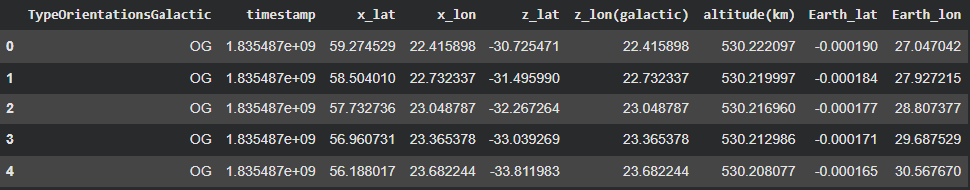
2. Inspecting the satellite data
A first glance
Our dataset mainly contains satellite metadata, that describes the orbital configuration of the satellite itself at different timestamps.

Slide 5
2. Inspecting the satellite data
The input features
The columns of the orientation dataframe constitute the input features of our regressor. It is therefore useful to clarify their physical meaning.
The x and z coordinates describe the orientation (attitude) of the spacecraft, i.e., the pointing directions of two of its body axes. The +X axis is a lateral axis defined by the mechanical structure of the spacecraft, while the +Z axis corresponds to the main primary pointing direction of the satellite (the boresight).
x_lat / x_lon: latitude and longitude of the spacecraft’s +X axis direction, expressed in an Earth-centered celestial reference frame.
z_lat / z_lon: latitude and longitude of the spacecraft’s +Z axis, i.e., the main pointing direction (boresight) projected in the same reference frame.
altitude: the orbital altitude (in km) of the satellite above Earth’s surface.
Earth_lat / Earth_lon: geographic latitude and longitude of the satellite’s sub-satellite point, i.e., the point on Earth directly underneath the spacecraft at each instant. These coordinates describe the satellite’s position along its orbit, independent of its pointing direction.

Slide 6
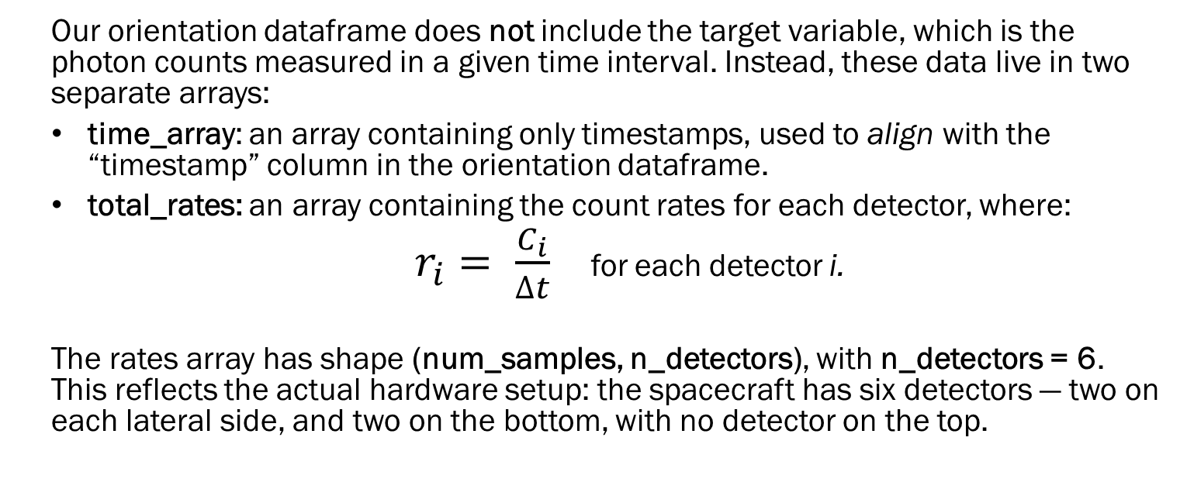
2. Inspecting the satellite data
Time/counts arrays and detectors
Our orientation dataframe does not include the target variable, which is the photon counts measured in a given time interval. Instead, these data live in two separate arrays:
time_array: an array containing only timestamps, used to align with the “timestamp” column in the orientation dataframe.
total_rates: an array containing the count rates for each detector, where:
$r_{i}= \frac{C_{i}}{∆t}$ for each detector i.
The rates array has shape (num_samples, n_detectors), with n_detectors = 6. This reflects the actual hardware setup: the spacecraft has six detectors — two on each lateral side, and two on the bottom, with no detector on the top.

Slide 7
2. Inspecting the satellite data
Time resolution and linear interpolation
We previously stated that the orientation dataframe includes a timestamp column where each row is spaced by a fixed 15-second interval. However, we also have three different time arrays available, each with a different temporal resolution:
15s 1s 50ms
The 15-second alignment is trivial, but for the 1-second and 50-millisecond arrays we need to interpolate the orientation features, so they match the finer time grids. We opt for simple linear interpolation (through np.interp()), deliberately ignoring any potential physical dynamics that might occur within those intervals.

Slide 8
2. Inspecting the satellite data
Visualizing count rates (numerically)
Num. Det. | 50ms | 1s | 15s
Detector 1 | 1460.0 | 1073.0 | 1061.3
Detector 2 | 1120.0 | 1047.0 | 1038.7
Detector 3 | 1200.0 | 885.0 | 880.5
Detector 4 | 900.0 | 895.0 | 928.3
Detector 5 | 960.0 | 863.0 | 845.5
Detector 6 | 720.0 | 850.0 | 845.4
For the first bin (the first row)

Slide 9
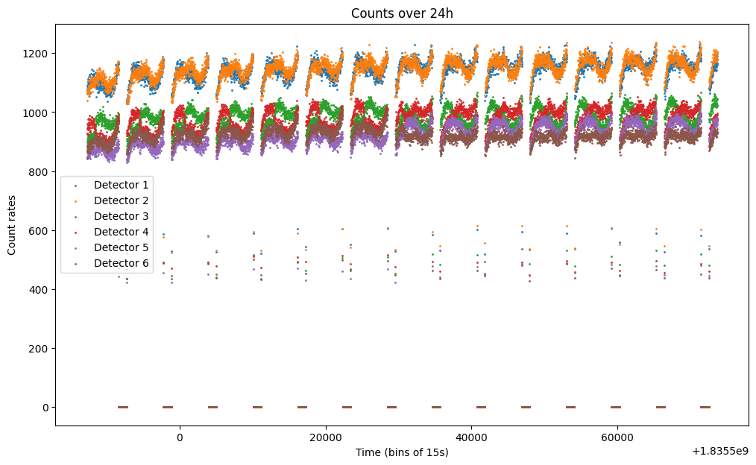
2. Inspecting the satellite data
Visualizing count rates (graphically)
The plot on the side shows the global distribution of the count rates, for each detector. In particular, we can see how the first two detectors behave similarly, having a mean count rate a bit higher than the one for the other detectors.

Slide 10
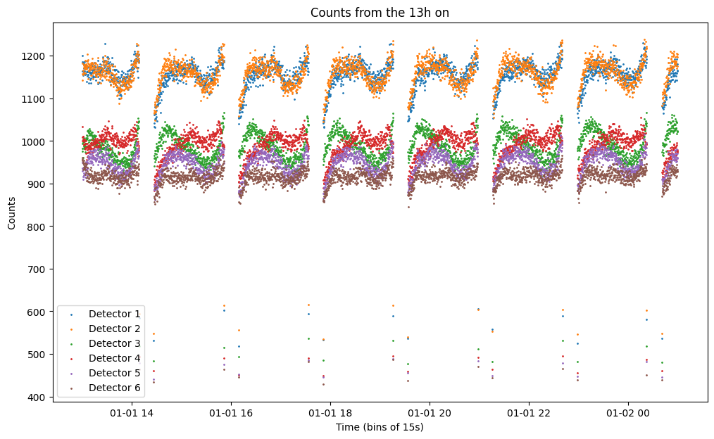
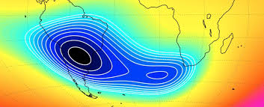
2. Inspecting the satellite data
Two clarifications
We will only consider data from the second half of the day, starting from the 13th hour. This is because during the first 12 hours the satellite is still activating, and its emission has not yet reached full intensity.
As we can clearly see from the previous plot, the count rates array is plenty of zeros. But why is that? This is due to the South Atlantic Anomaly (SAA) where the satellite is off while it transits the SAA. Indeed, the satellite gathers zero count rates in those temporal windows. Because of that, we can safely delete those rows which contain zero values in their count rates columns.

Slide 11
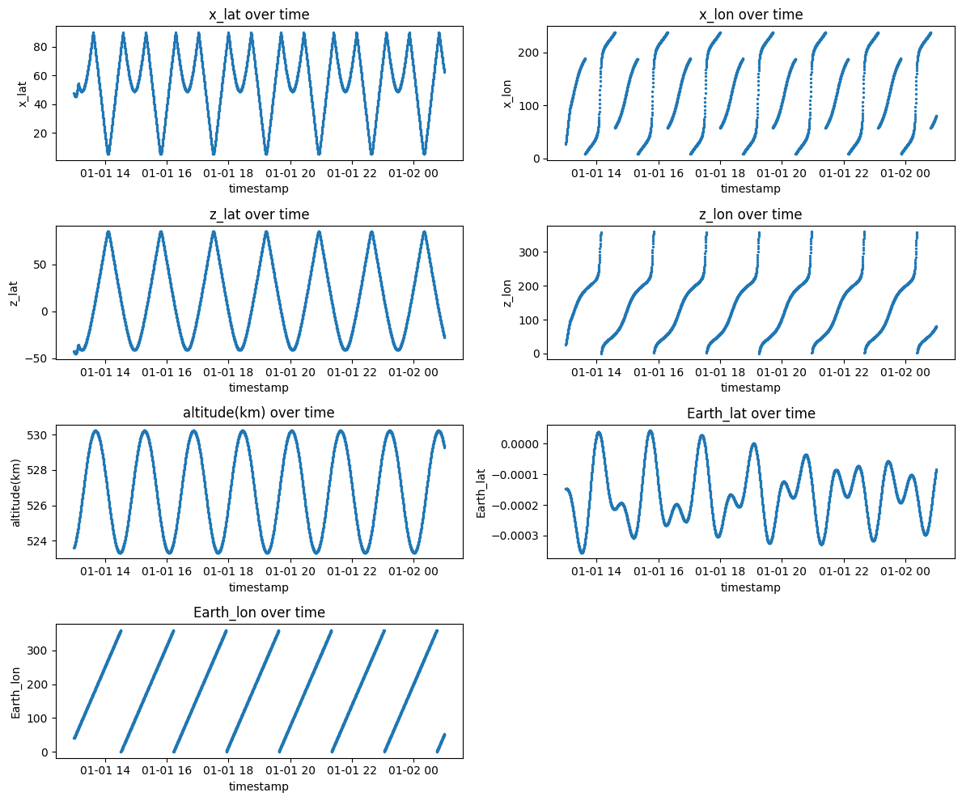
2. Inspecting the satellite data
Input features distribution

Slide 12
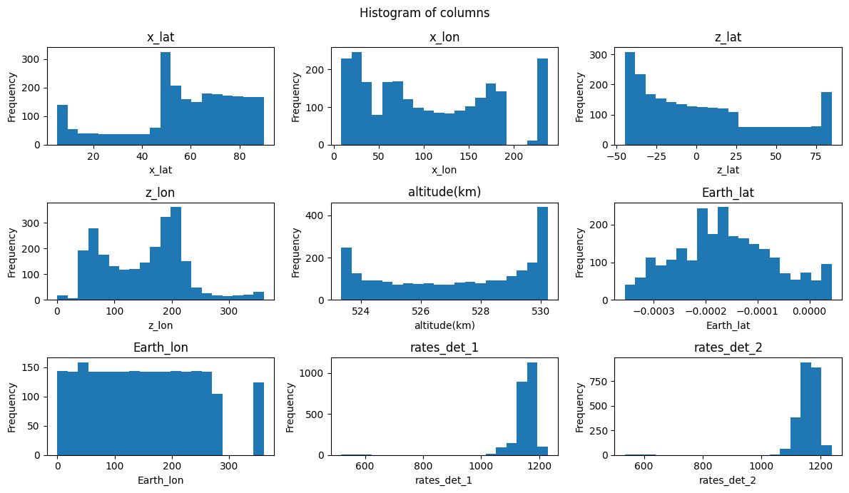
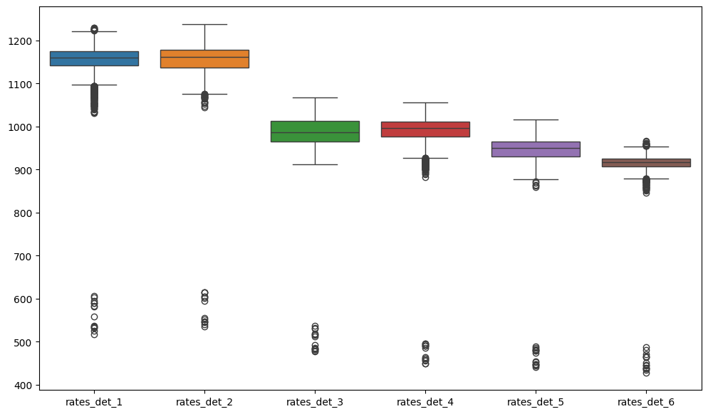
3. A statistical analysis
Feature boxplots and histograms
Features histogram
Count rates boxplots

Slide 13
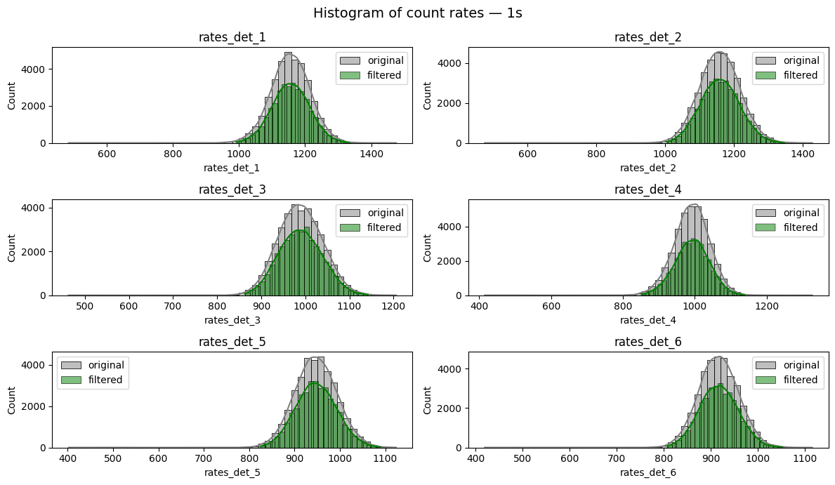
3. A statistical analysis
Removing outliers
Overall, we remove the 5% of the data, but the one on the tails. Since they are left-skewed, the quantiles are asymmetric.
def remove_outliers_quantiles(df):
num_cols = df.select_dtypes(include=np.number).columns
lower = df[num_cols].quantile(0.004)
upper = df[num_cols].quantile(0.999)
mask = ((df[num_cols] >= lower) & (df[num_cols] <= upper)).all(axis=1)
df_filtered = df[mask]
return df_filtered

Slide 14
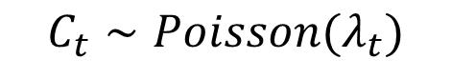
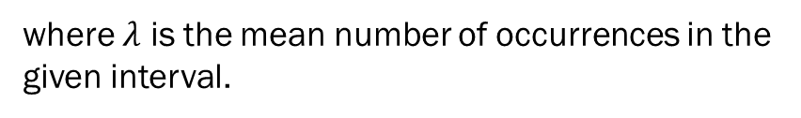
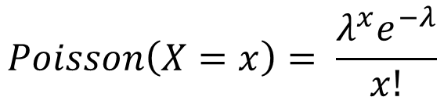
3. A statistical analysis
Theoretical count rate distribution
In order to analyze the count rate distribution, that in our case is a per-bin distribution (within each 15s bin).
Theoretically, the underlying process of a counting experiment is a Poisson, because we count independent events over a fixed time interval.
Indeed, our physical model is:
$$Poisson\left(X=x\right)= \frac{λ^{x}e^{−λ}}{x!}$$
$$C_{t}∼Poisson(λ_{t})$$
$$s.t.$$
where $λ$ is the mean number of occurrences in the given interval.

Slide 15
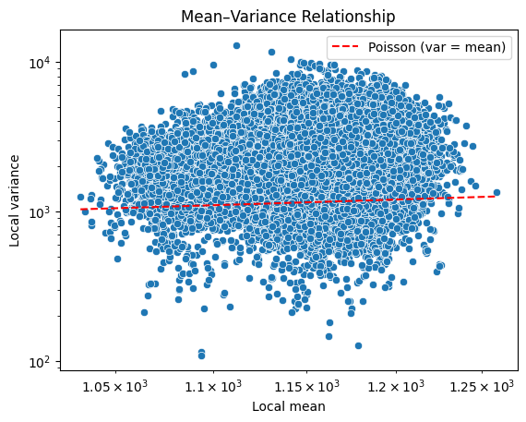
3. A statistical analysis
First issue: overdispersion (var >> mean)
Detector 1: median φ = 2.260
Detector 2: median φ = 2.278
Detector 3: median φ = 1.649
Detector 4: median φ = 1.651
Detector 5: median φ = 1.692
Detector 6: median φ = 1.689
As we can see from the plot (in log-scale) and the results above, there is a clear sign of overdispersion (here 50s).
The observed variance is several times larger than the Poisson expectation, around the average count.
A plain Poisson regression will systematically underestimate uncertainty and produce biased λ estimates. Larger windows blend distinct states and inflate variance.

Slide 16
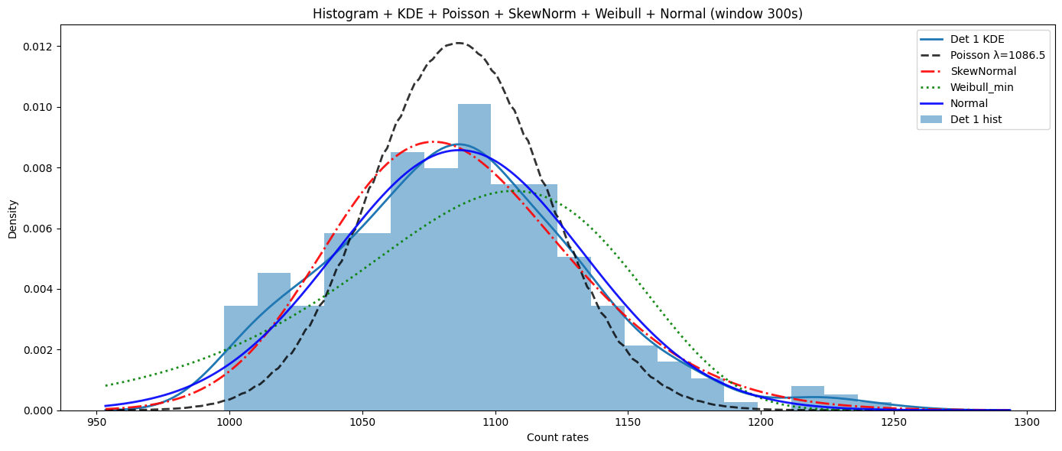
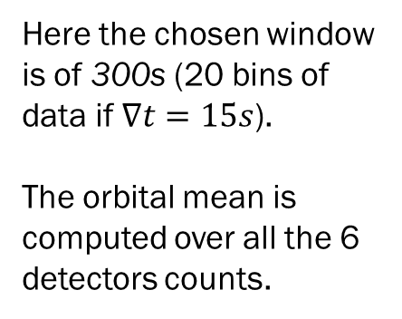
3. A statistical analysis
Count rate distribution | 1s
In order to properly analyze the count rate distribution, we should extract a stationary small window of data, to avoid to include any kind of orbital trend. Here, we will choose a representative window that is the closest to the orbital mean count.
Here the chosen window is of 300s (20 bins of data if $∇t=15s$).
The orbital mean is computed over all the 6 detectors counts.

Slide 17
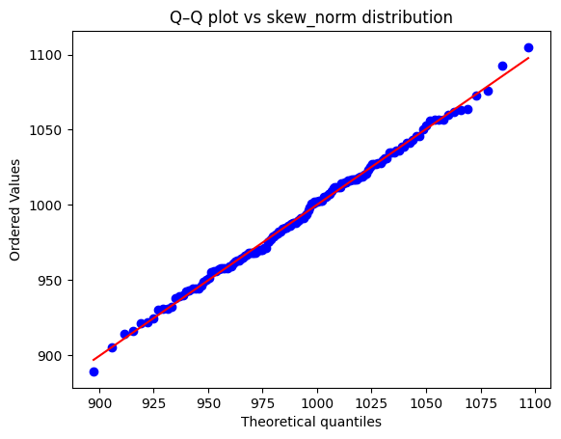
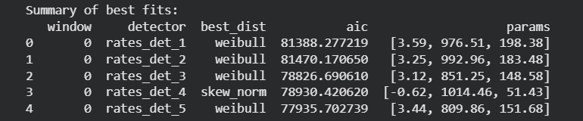
3. A statistical analysis
Count rate distribution | 1s
The best fitting distributions for a series of contiguous windows are the Weibull (min) and the Skew Normal distributions.
To compare how well the different probabilistic regressors fit the data, we use the Akaike Information Criterion (AIC). It estimates the relative amount of information lost by a given model: the less information a model loses, the higher the quality of that model.

Slide 18
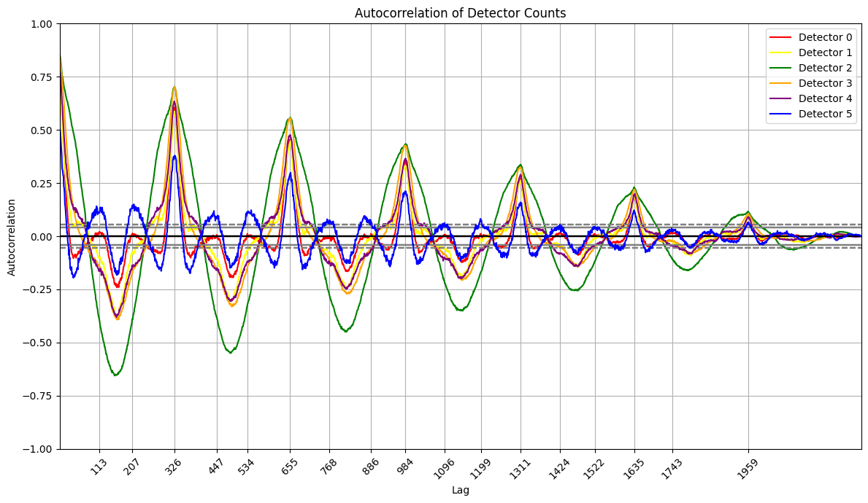
3. A statistical analysis
Autocorrelation plot: count rates
All the detectors share somehow the same correlation pattern. Indeed, there are peaks that are repeating at regular intervals, which suggest periodicity. Noisier detectors shows a more irregular pattern.
Each peak happens every 326 lags, ~1.36 hours; negative peaks indicate an inverse relationship
We can also spot a temporal decay: the time series is still repeating, but each repetition is a little less like the original one. This correlation, both positive and negative, means that the pattern decreases over time. This is due to damping or the fact that noise accumulates over time.

Slide 19
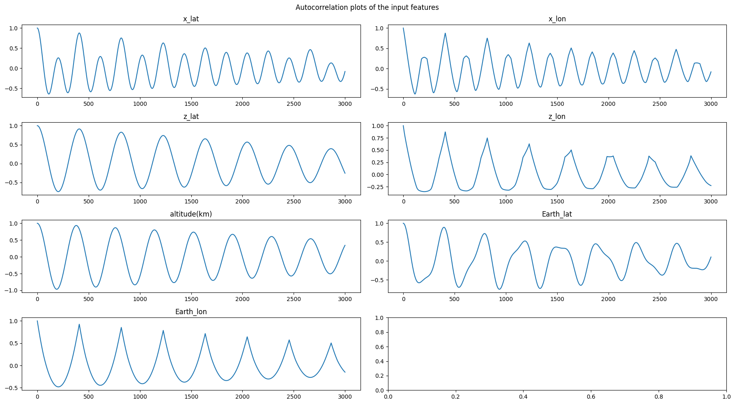
3. A statistical analysis
Autocorrelation plot: input features
Clear periodicity
As before, we can also spot a temporal decay.

Slide 20
4. Regression
Train-test split and normalization
We split the available dataset into two distinct test subsets, each serving a different purpose:
Random Test Set: This set consists of randomly sampled, non-contiguous timesteps. It is used to evaluate the model on heterogeneous orbital configurations and to compute global performance metrics (e.g., MAE, RMSE, NLL). These random samples represent the typical distribution of inputs seen during training.
Contiguous Test Set: The second test subset contains a long, contiguous sequence of timesteps. This is required to generate continuous background light curves and to visually assess temporal coherence in the model’s predictions. Contiguous windows allow us to inspect whether the regressor captures the slow orbital trends and geomagnetic modulations that appear in real background data.
Before training, all input features are standardized using a StandardScaler fitted exclusively on the training subset. This ensures that each feature has zero mean and unit variance, improving convergence during optimization and preventing information leakage from the test sets. The same scaler is then applied unchanged to both test subsets.

Slide 21
4. Regression
Evaluation metrics
To evaluate the regressor, we compute several standard error metrics that quantify different aspects of prediction quality:
RMSE: it penalizes large errors more heavily because of the square. It measures the average magnitude of the prediction error with emphasis on outliers. A lower RMSE means the model follows the target values more closely, especially in regions with high variability.
MAE: it computes the average absolute deviation between predictions and true values. It treats all errors equally and is easier to interpret than RMSE. A low MAE indicates that, on average, predictions are close to the ground truth with no bias from extreme cases.
Mean Absolute Percentage Error: It measures the average relative error, normalizing the deviation by the true value.
R²: it measures how much of the variance in the true signal is explained by the model, capturing how well the model reproduces the overall structure and variability of the target data.

Slide 22
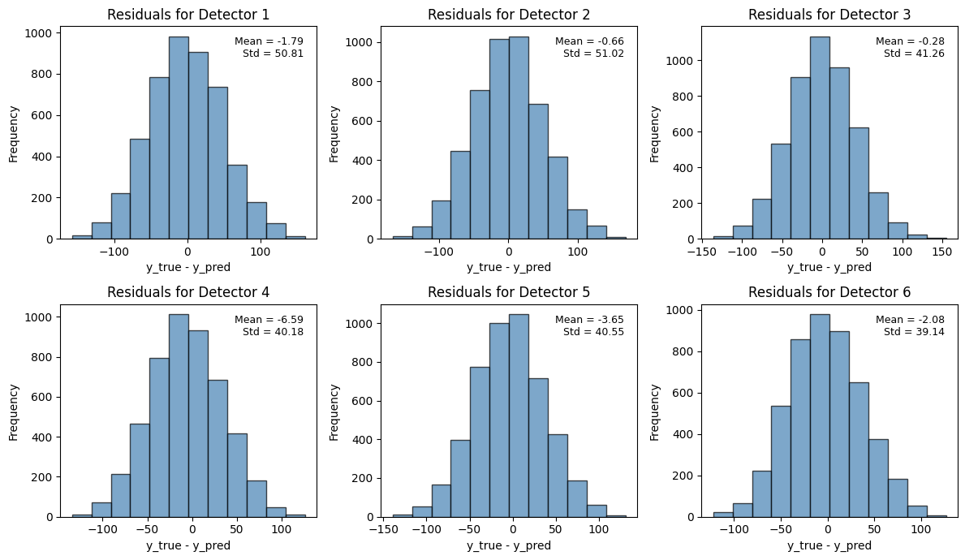
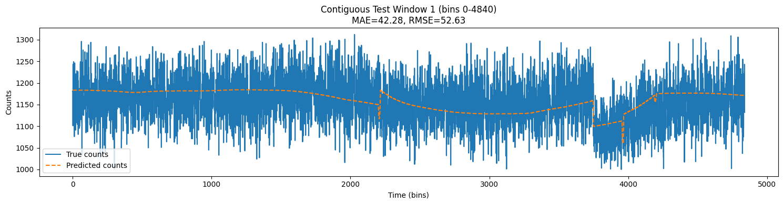
4. Regression
Standard Regressor baseline | 1s
These are the results of a naïve dense regressor. The residuals are approximately normally distributed and the learned mean background signal seems faithful.

Slide 23
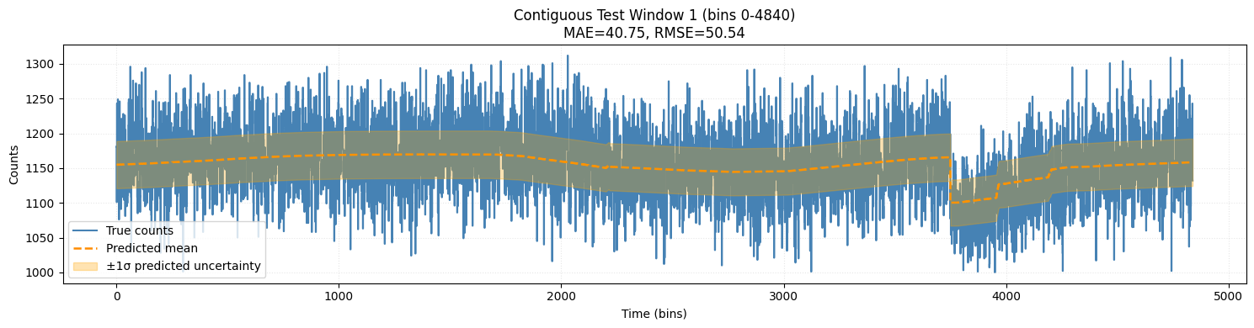
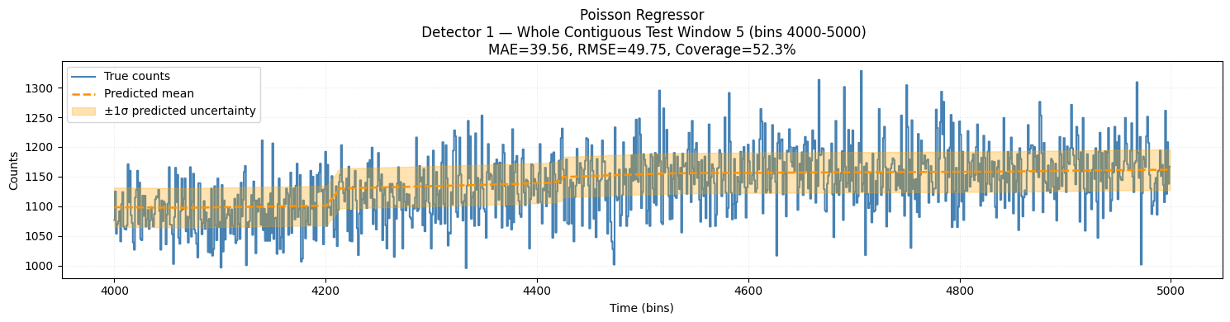
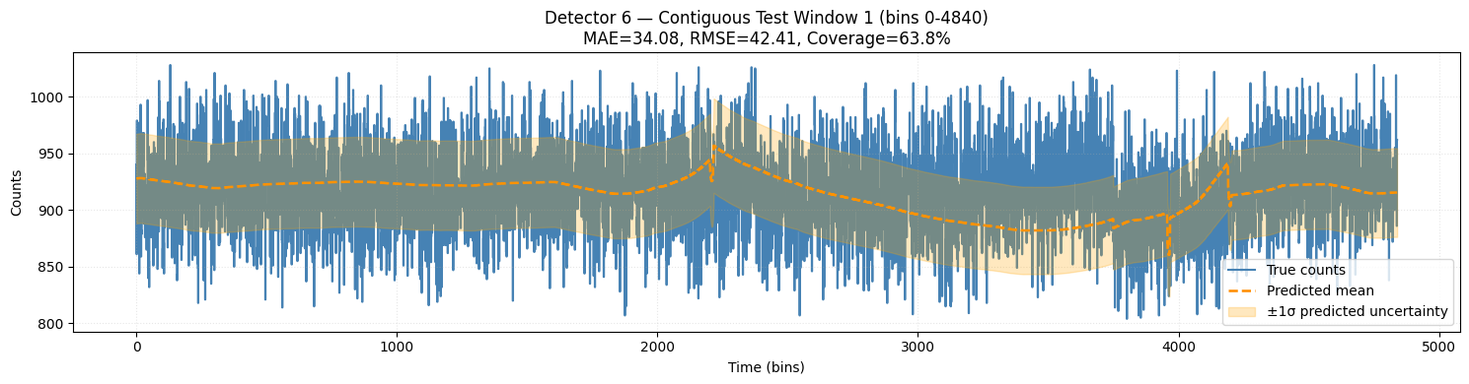
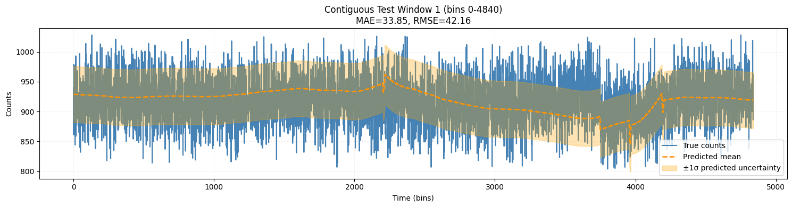
4. Regression
Poisson
Test MAE = 43.5
Percentage error = 4.25%
Neuro-probabilistic baselines
| 1s
Skew-norm
Test MAE = 35.3%
Percentage error: 3.46%
Weibull_min
Test MAE = 54.2%
Percentage error: 5.29%

Slide 24
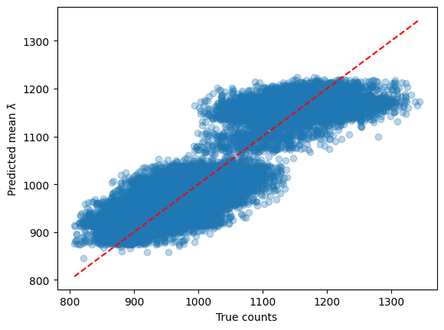
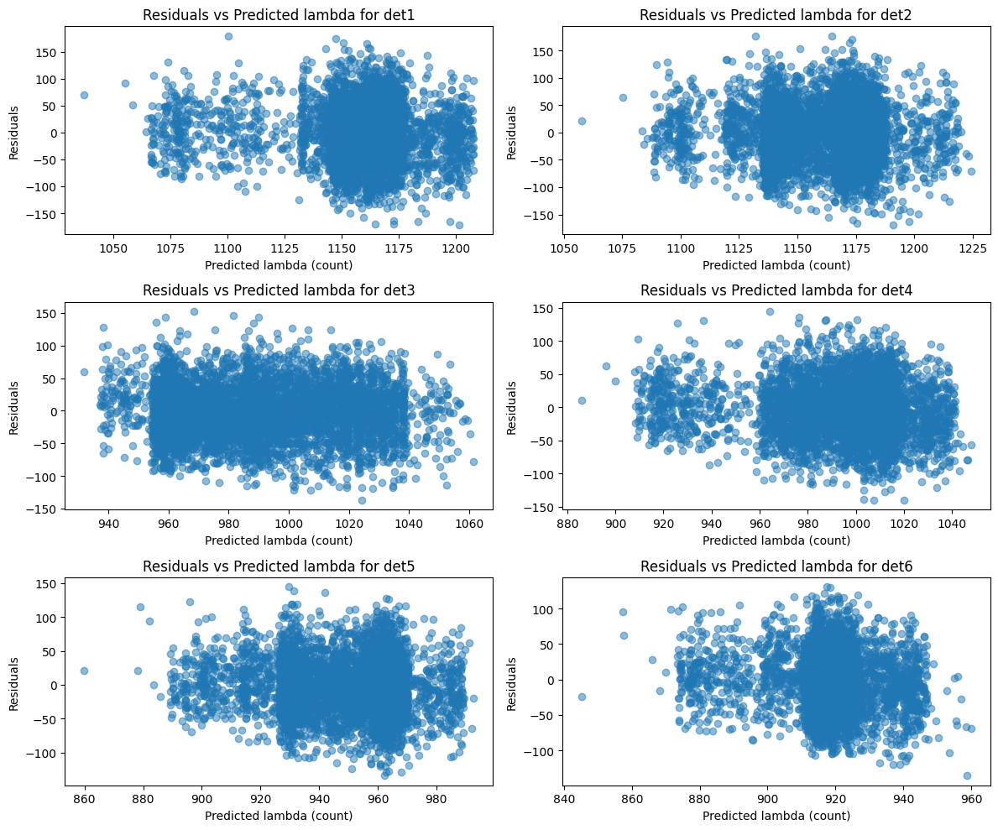
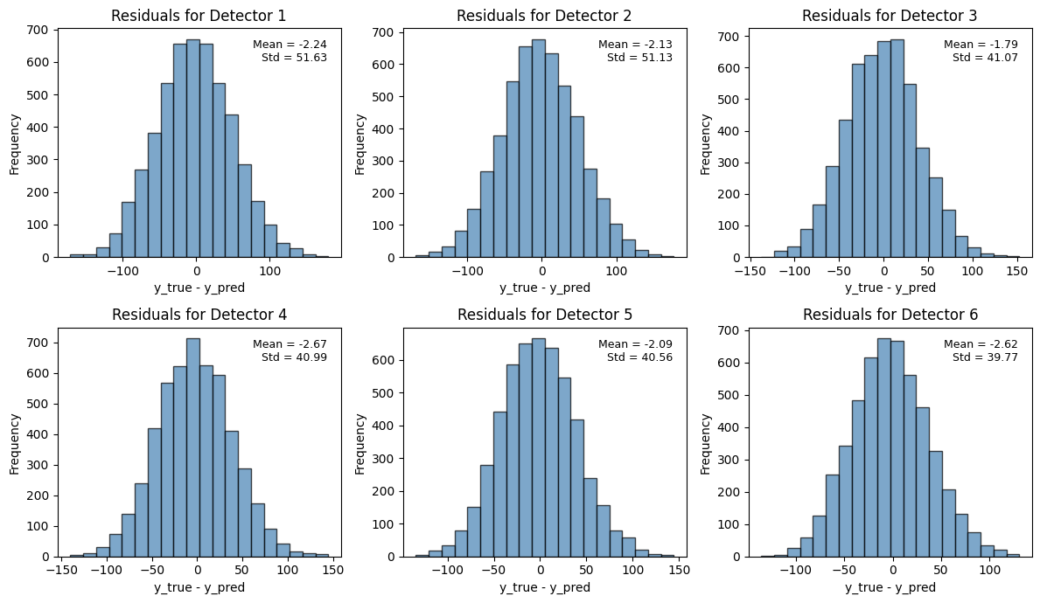
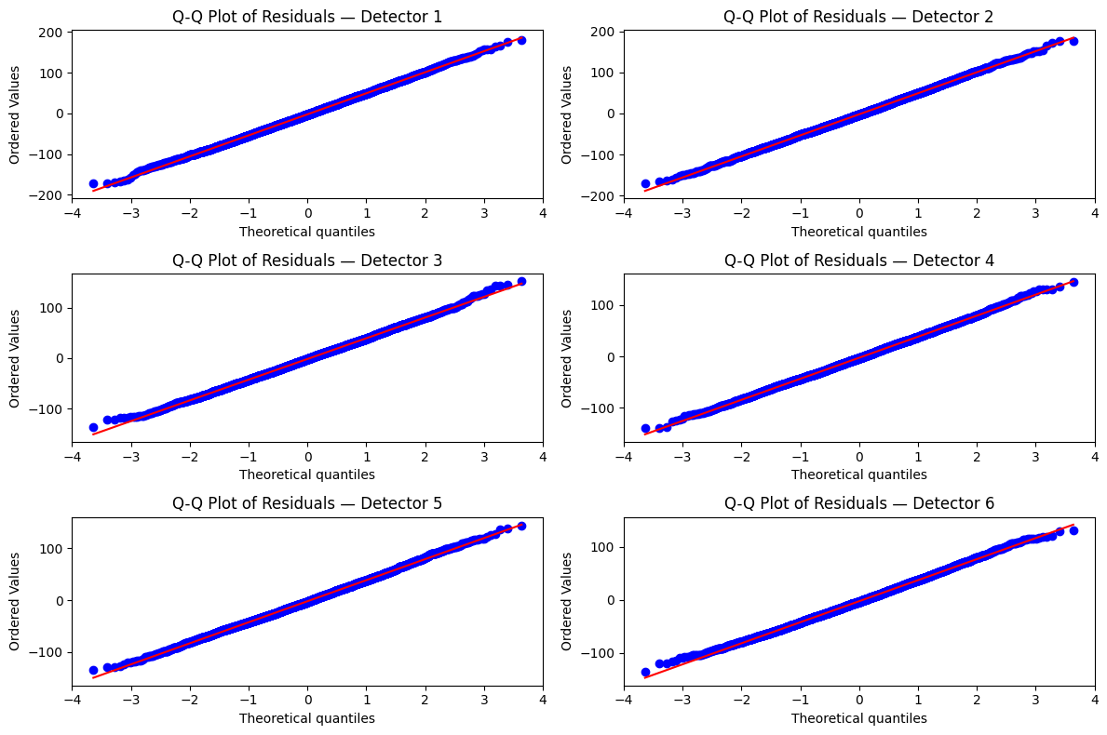
4. Regression
Neuro-probabilistic baselines
| 1s
Skew-normal
Avg var/mean = 1.85
Avg mean = - 2.10

Slide 25
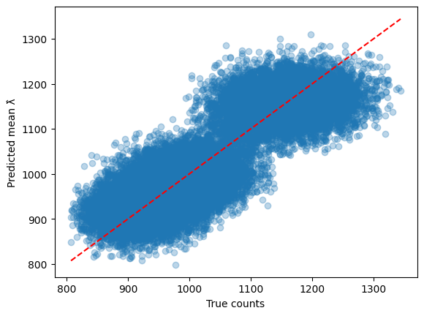
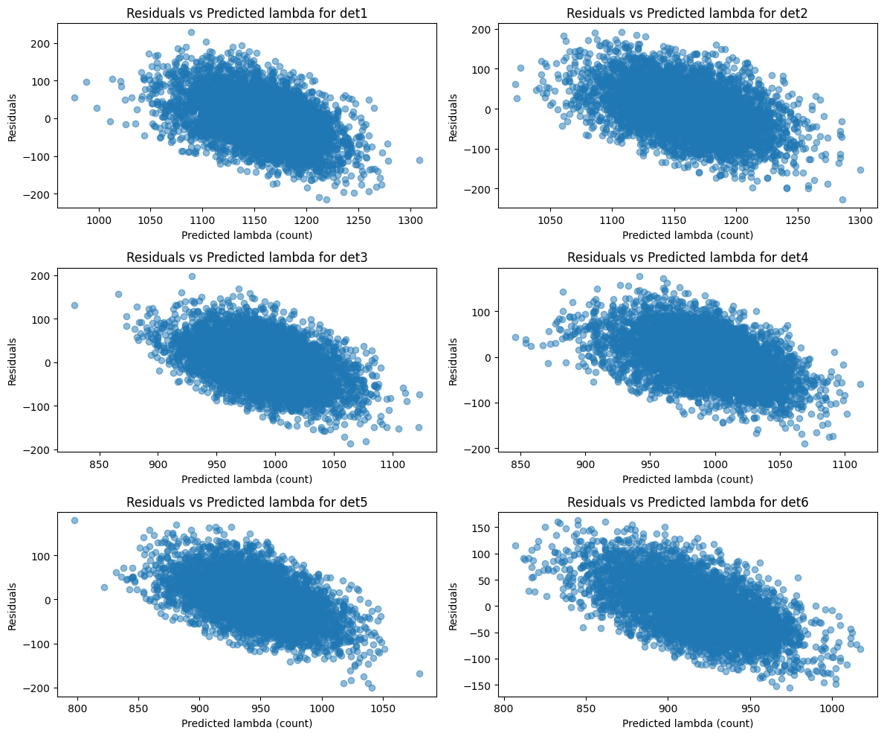
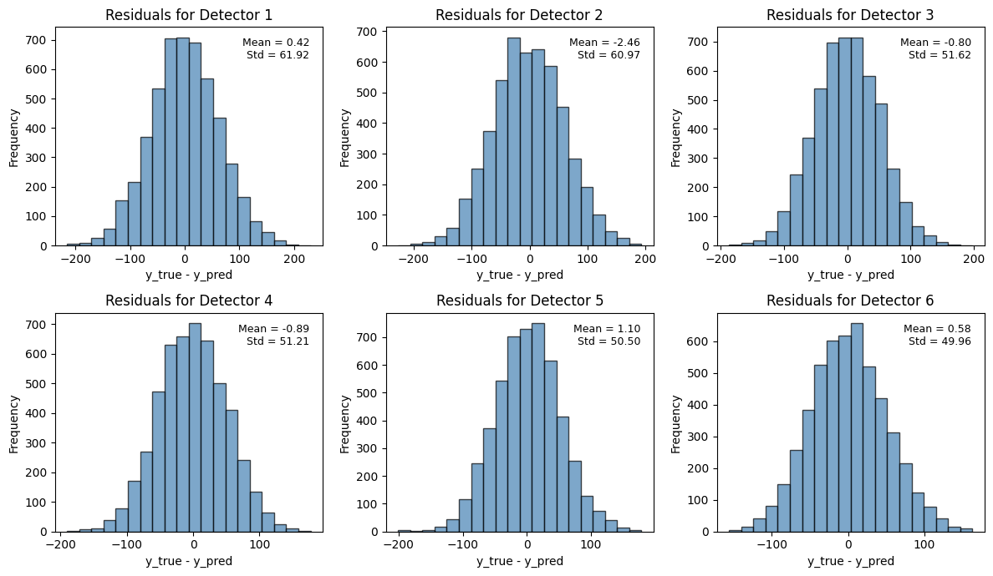
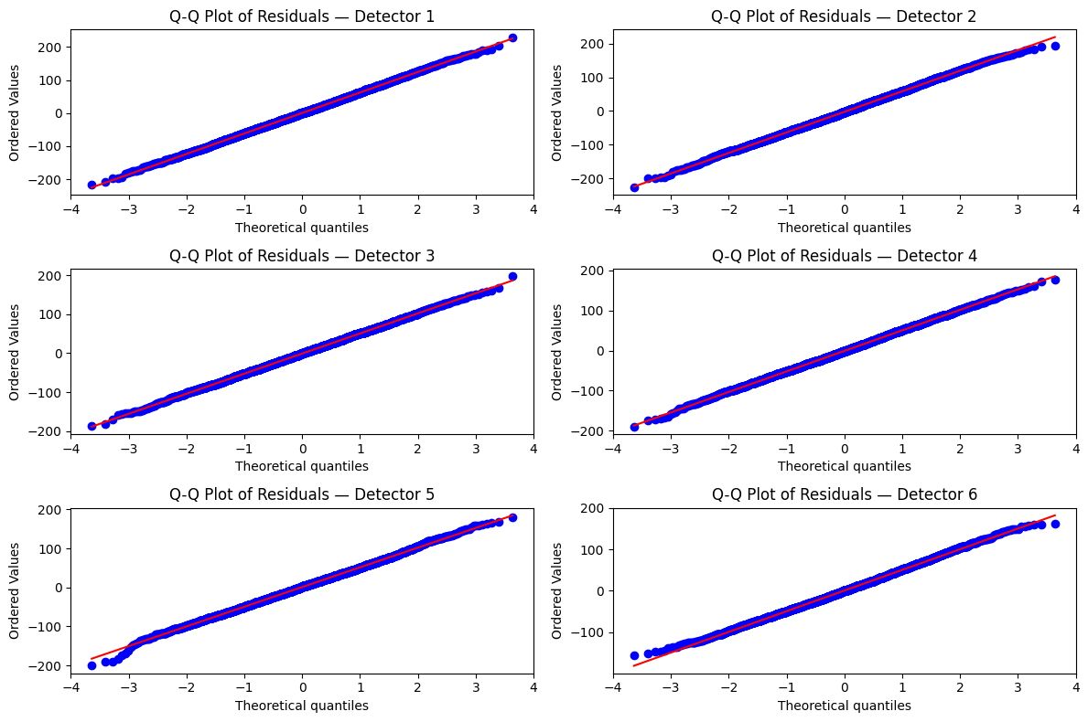
4. Regression
Neuro-probabilistic baselines
| 1s
Poisson
Avg var/mean = 2.75
Avg mean = - 0.34

Slide 26
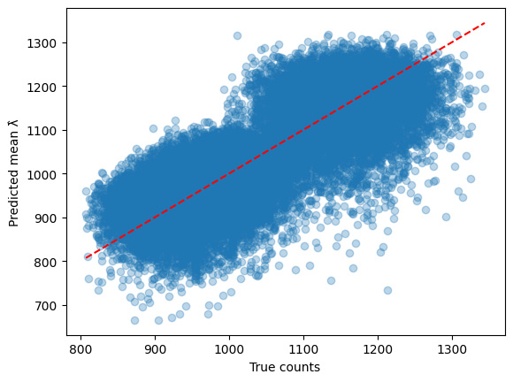
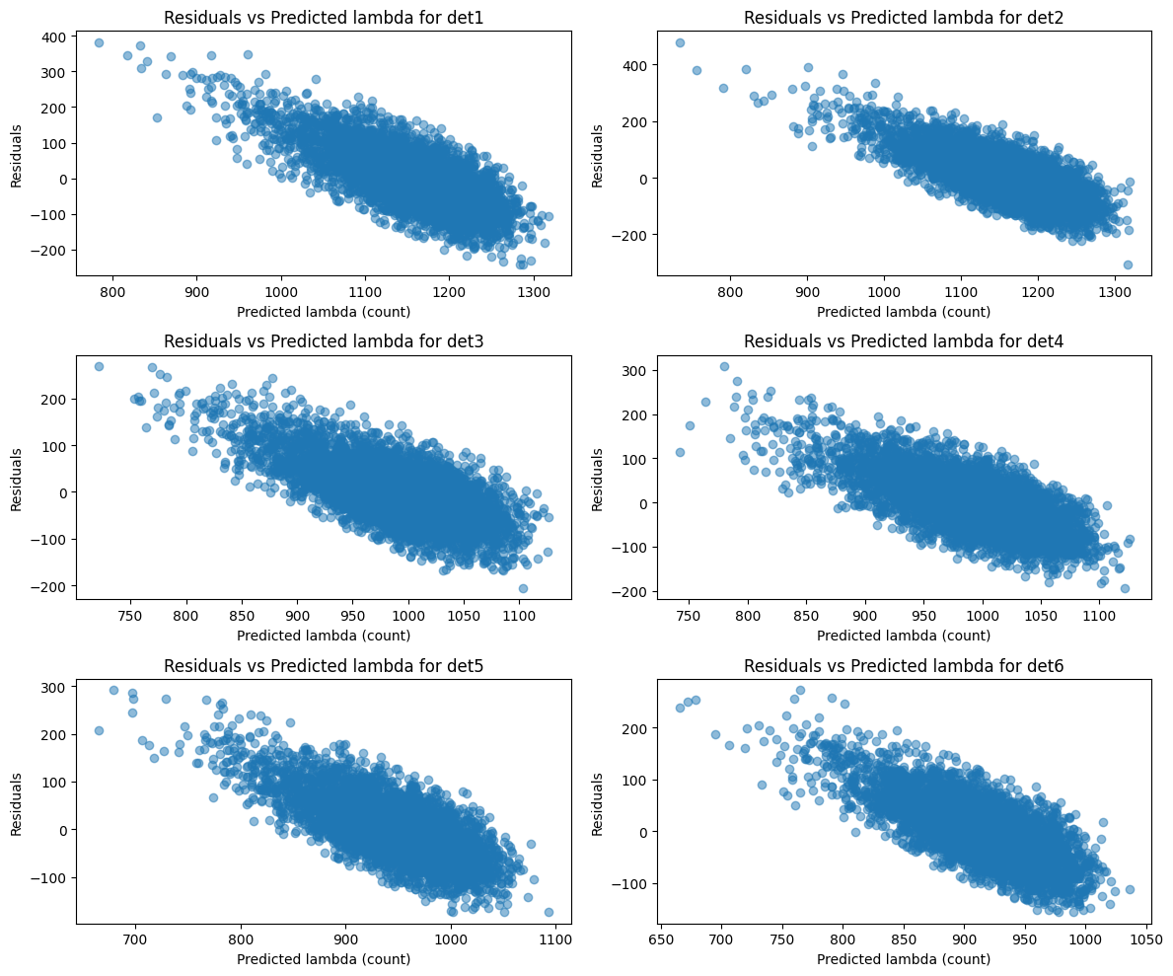
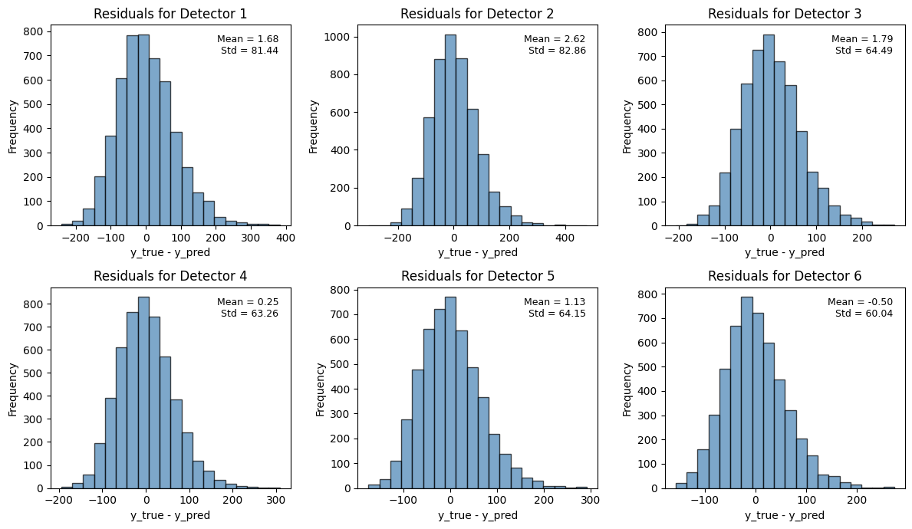
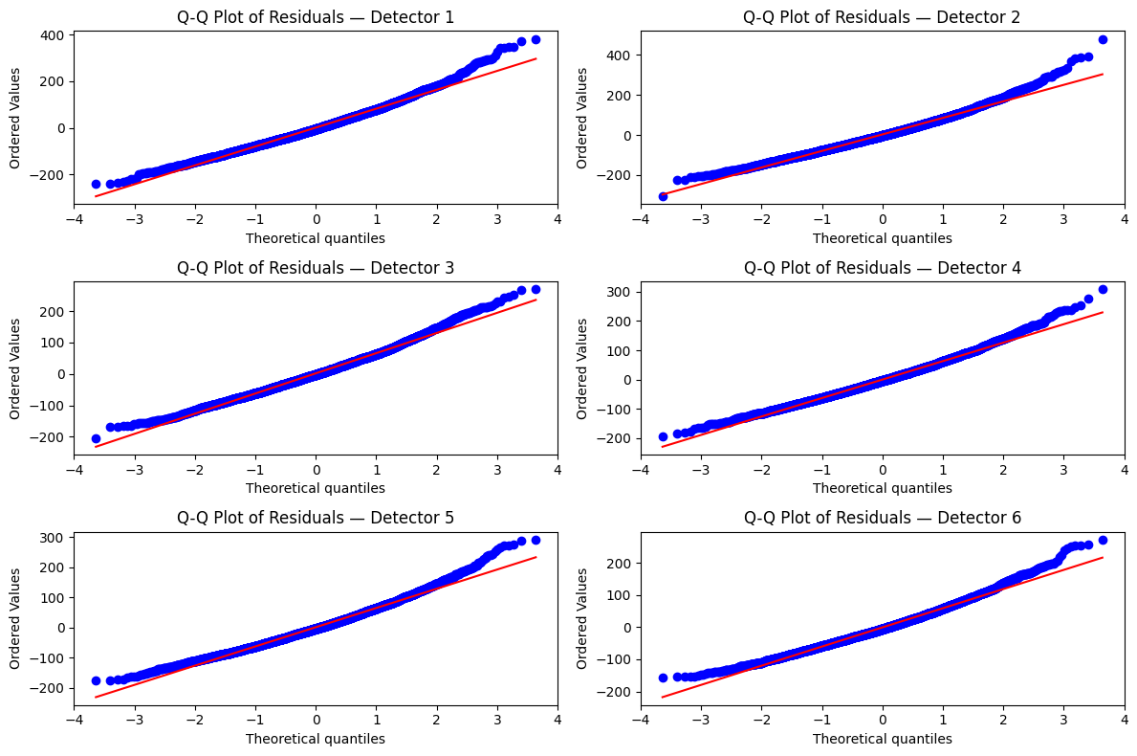
4. Regression
Neuro-probabilistic baselines
| 1s
Weibull
Avg var/mean = 4.51
Avg mean = 1.16

Slide 27
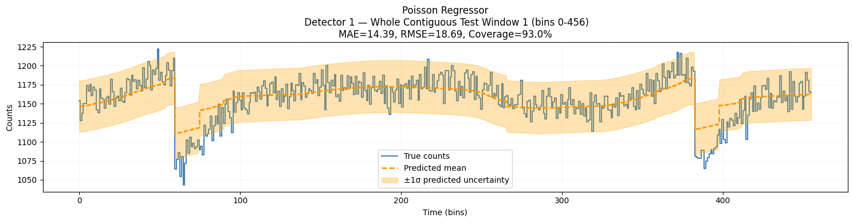
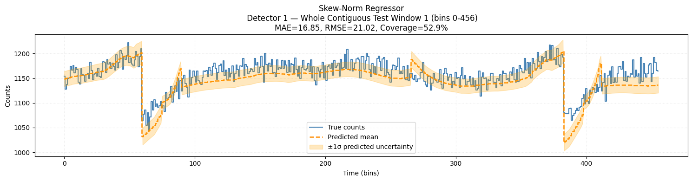
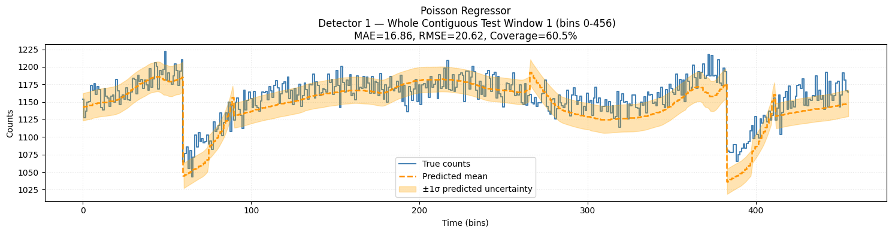
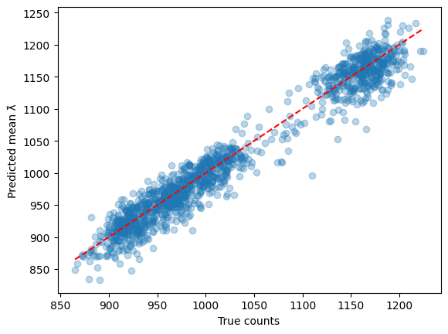
4. Regression
Neuro-probabilistic baselines
| 15s
Poisson
Percentage error = 2,72%
Skew-norm
Percentage error: 1,26%
Weibull_min
Percentage error: 1,67%

Slide 28
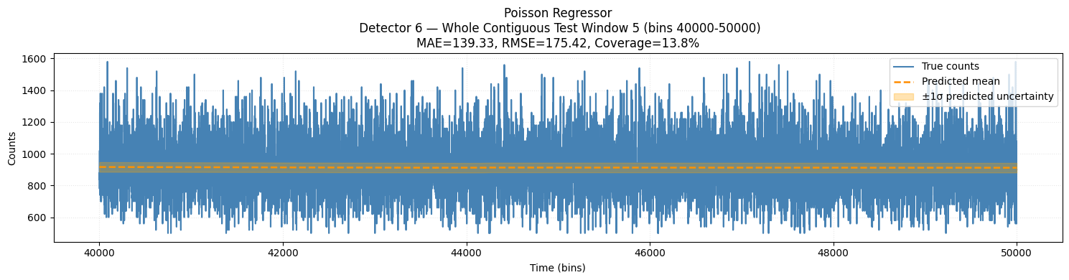
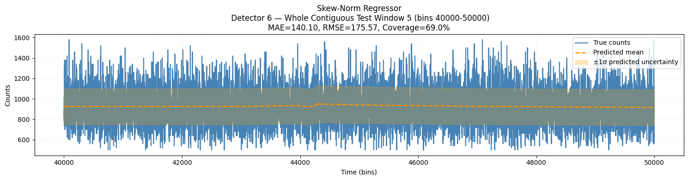
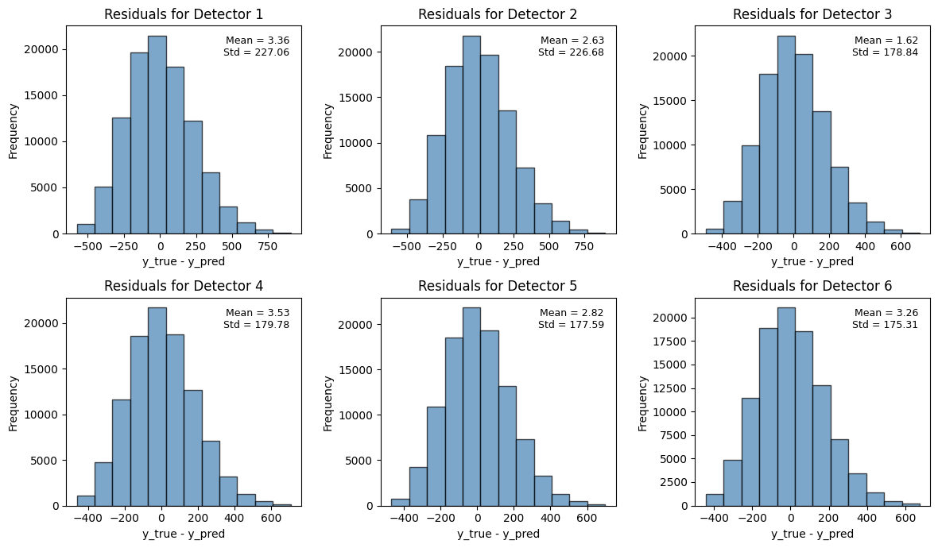
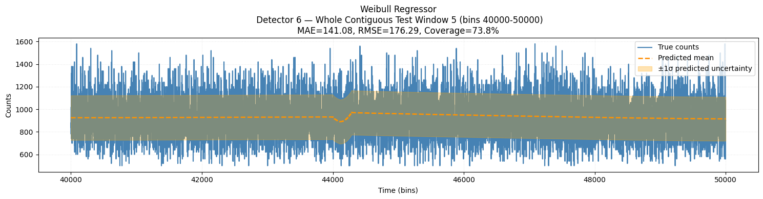
4. Regression
Neuro-probabilistic baselines
| 50ms
Poisson
Percentage error = 15,98%
Skew-norm
Percentage error:
15,74%
Weibull_min
Percentage error: 23,52%

Slide 29
4. Regression
Considerations
As we have seen, the Poisson regressor cannot model overdispersion: its mean and variance are constrained to be equal. At 15-second resolution, where the background exhibits strong orbital and geomagnetic variability, the data are highly overdispersed. In this regime the Poisson model has no dispersion parameter to absorb the excess variance, so it artificially inflates the mean λ to explain the noise. In practice, all the unmodelled variability is pushed into the predicted mean, producing large oscillations and poor calibration.
In contrast, at 50ms the physical process is much closer to a pure Poisson regime—photon counts are low, and variance is naturally small. Consequently, the Poisson model behaves well and reproduces the observed variability.
Skew-Normal and Weibull distributions include separate dispersion (and shape) parameters, allowing them to model the mean, the extra variance, and possible asymmetry independently. This flexibility enables them to capture the overdispersed behavior present at 15s without distorting the mean prediction.

Slide 30
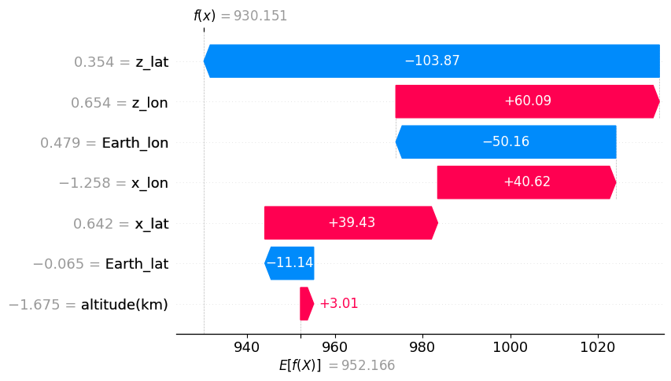
5. SHAP
Local interpretability (SN – 1s)
If we don't have access to any input feature, the predictions is supposed to be ~952 (the population average).
Our current prediction for the chosen sample is lower than the population average (the baseline), and the Shapley values of each features tells us that the z_lat and x_lon features are the one that are the most impactful.

Slide 31
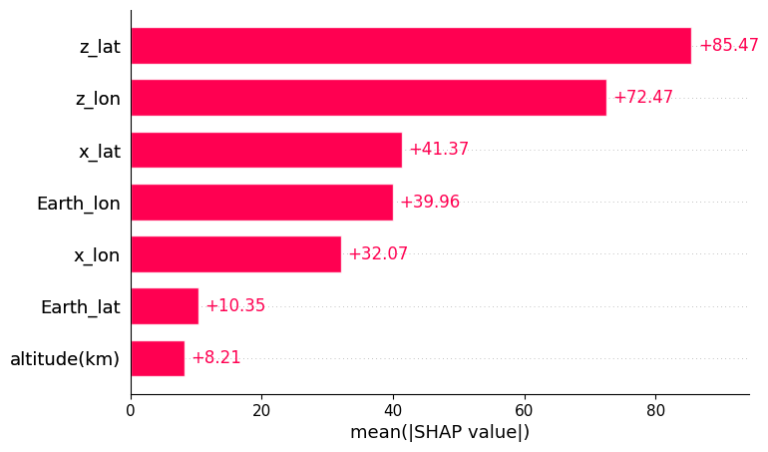
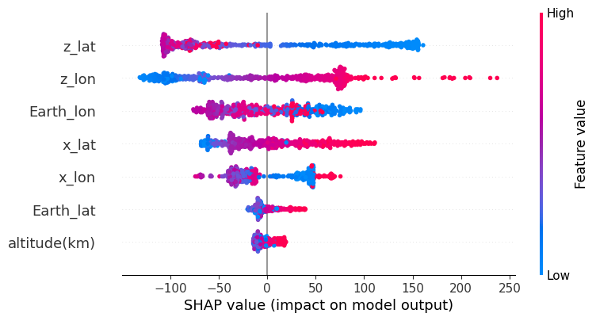
5. SHAP
Global interpretability (SN – 1s)
z_lat and z_lon are the most influential features
There is a negative correlation between z_lat and its shapely values; instead, there is a smoother and clearer positive one for z_lon.

Slide 32
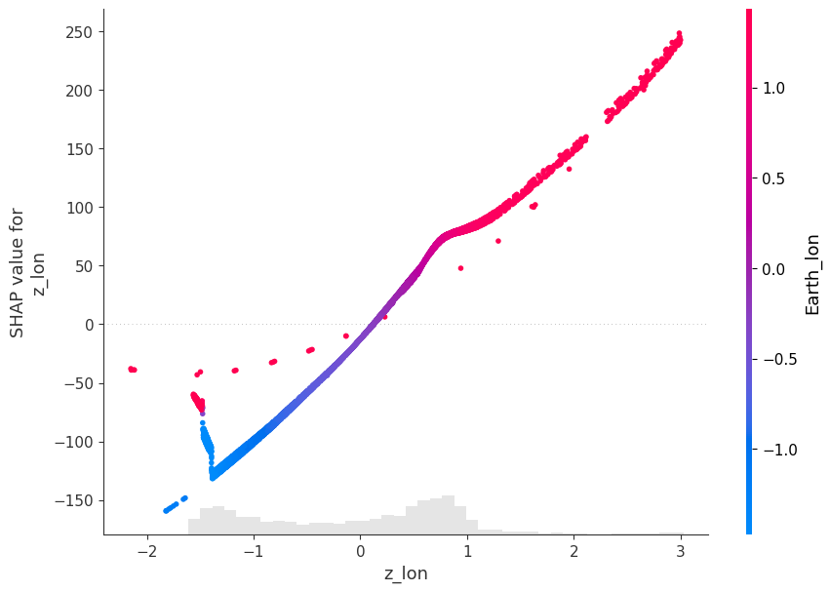
5. SHAP
Global interpretability
There is a clear positive relationship between z_lon and its SHAP values: higher values of z_lon lead to increasingly positive contributions to the predicted background, while lower values lead to negative contributions. The point where SHAP values cross zero (roughly at z_lon ≈ 0.4) indicates the threshold at which the feature shifts from decreasing the prediction to increasing it.
The dependence plot is colored by the feature that interacts most strongly with z_lon, identified as Earth_lon. The color pattern shows that Earth_lon modulates the effect of z_lon: when Earth_lon is close to 0, the SHAP values of z_lon tend to be small or positive, whereas for Earth longitudes farther from 0 the influence becomes strongly positive or strongly negative. This demonstrates a clear interaction between the two features

Slide 33
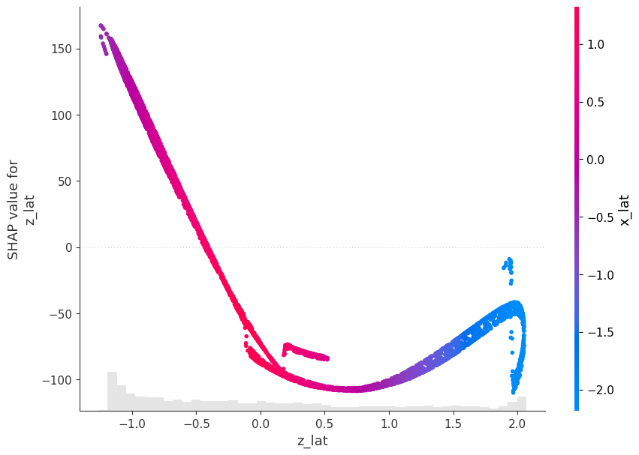
5. SHAP
Global interpretability
In this dependence plot we observe a behavior like the one seen for z_lon, but with an overall negative relationship between z_lat and its SHAP values. As z_lat increases, the SHAP contribution initially decreases, reaching a strong negative minimum, and then slowly rises again at higher values — producing the characteristic “golf-club” shape.
The color scale indicates the feature that interacts most strongly with z_lat, identified here as x_lat. The transition in colour shows that the effect of z_lat depends on the value of x_lat: when x_lat is close to zero or positive (purple/red), z_lat produces increasingly negative SHAP values as it grows. Conversely, when x_lat becomes more negative (blue), the SHAP values start increasing again at larger z_lat.

Slide 34
5. SHAP
Considerations | from a physical p.o.v.
The SHAP analysis is consistent with the expected physical behavior of the background.
As observed, z_lat and z_lon emerge as the most influential features. This is physically reasonable, since together they encode the latitude and longitude of the spacecraft’s main boresight direction—i.e., where the detector is pointed at each instant. The prominence of z_lat is also coherent with the physics: the pointing latitude should be more stable — it has a broader field of view — than the pointing longitude, which varies over a narrower range and contributes less strongly.

Slide 35
6. KAN

